Slide 1
How to Use RStudio on Codespaces

Slide 2
Go to https://github.com/codespaces
Log in or create a GitHub account if prompted
Proceed to the next slides

Slide 3
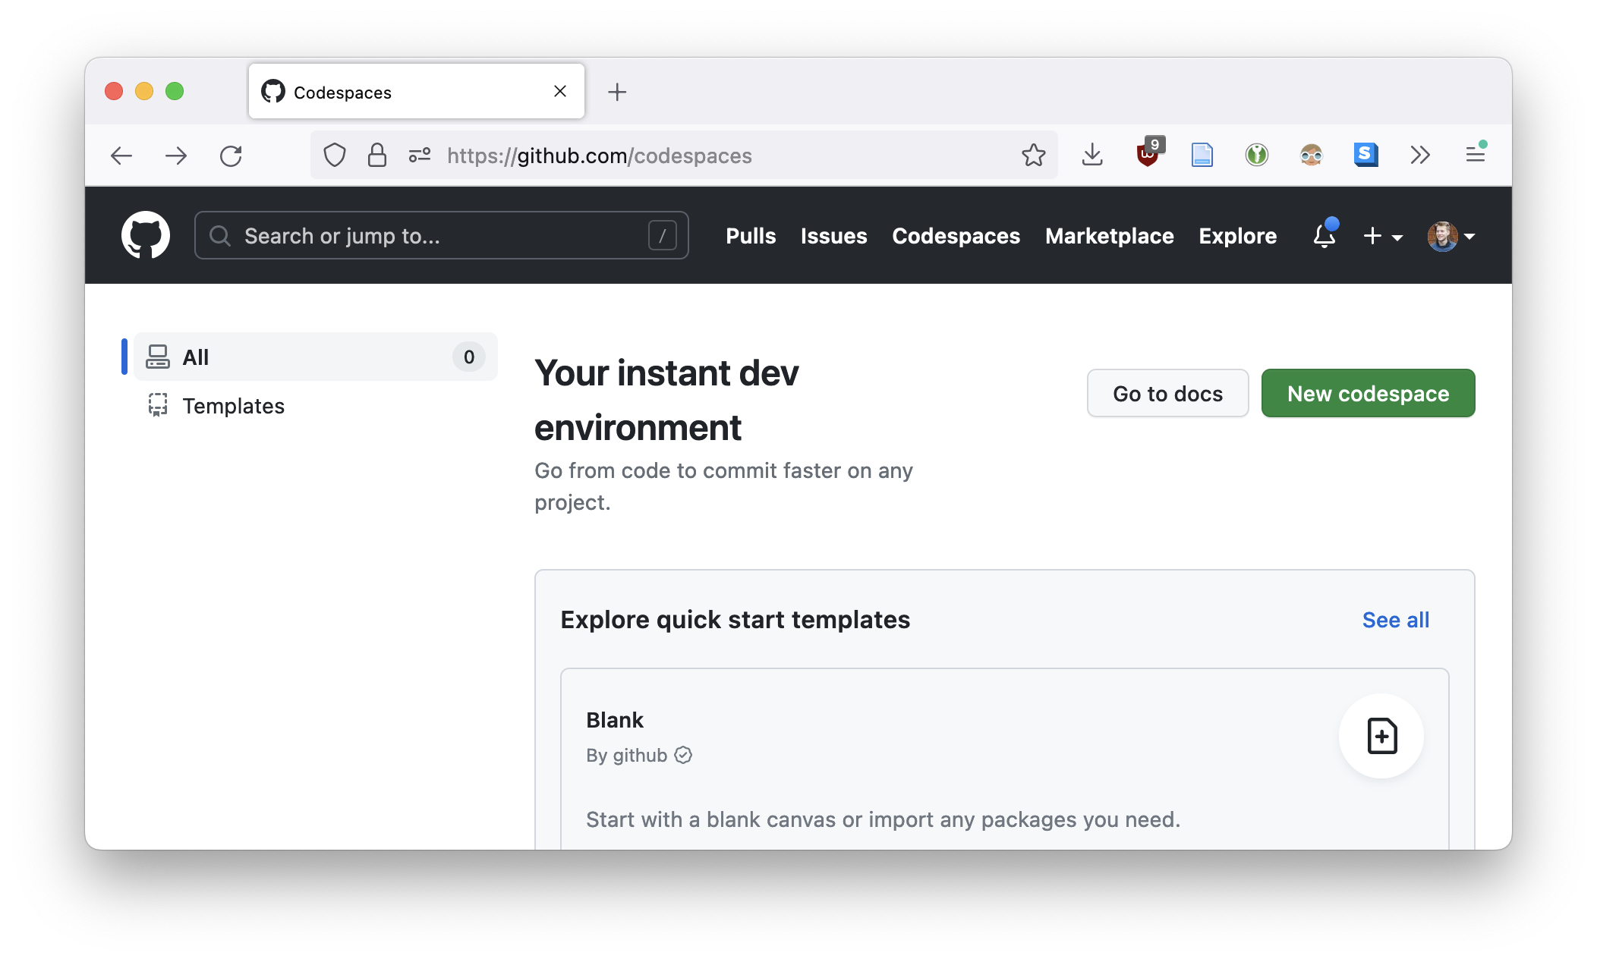
Click

Slide 4
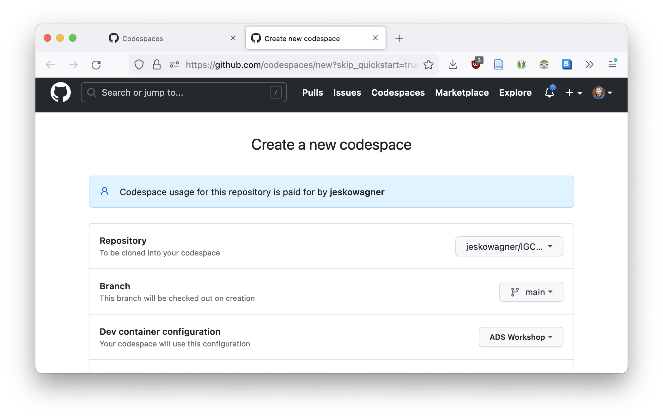
jeskowagner/IGC-ADSWorkshop

Slide 5
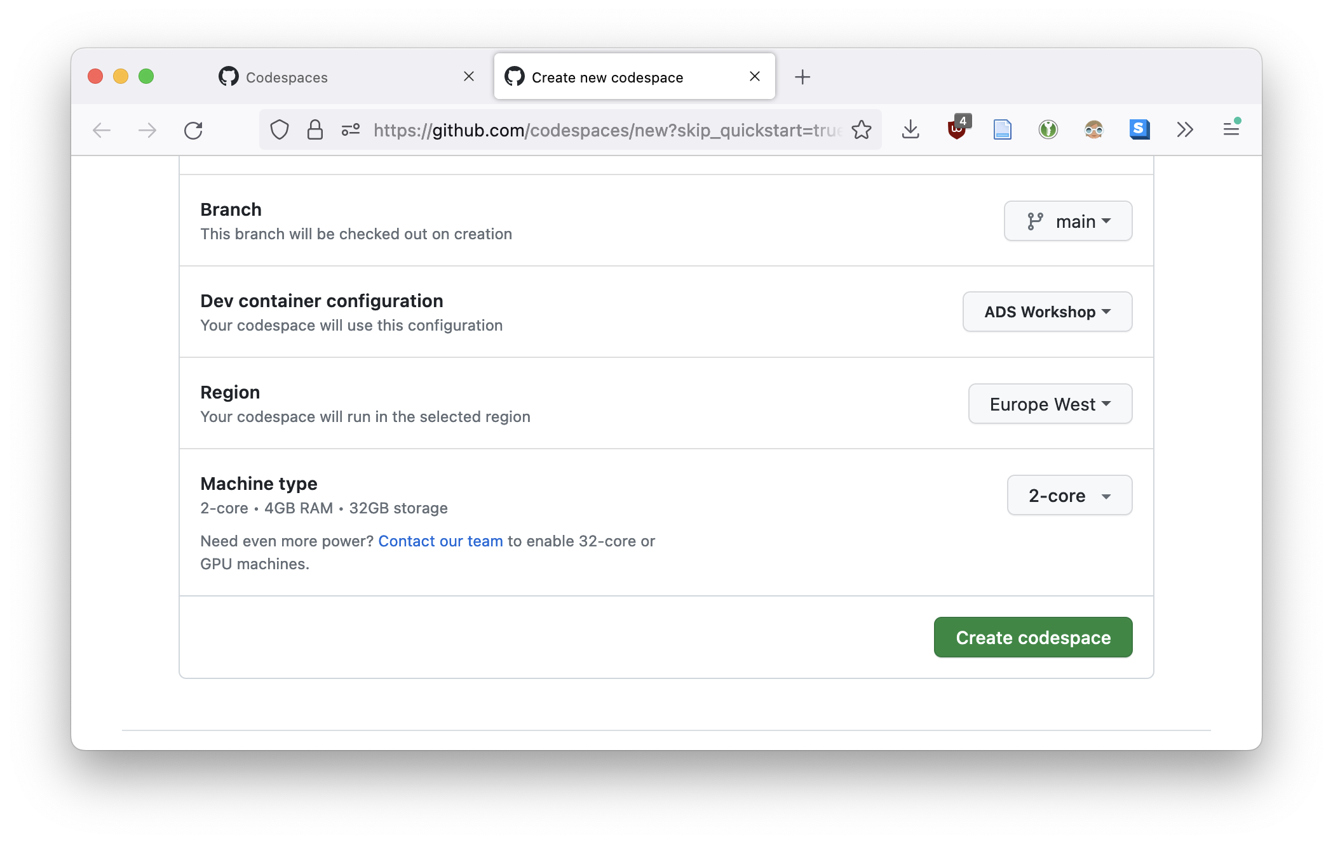

Slide 6
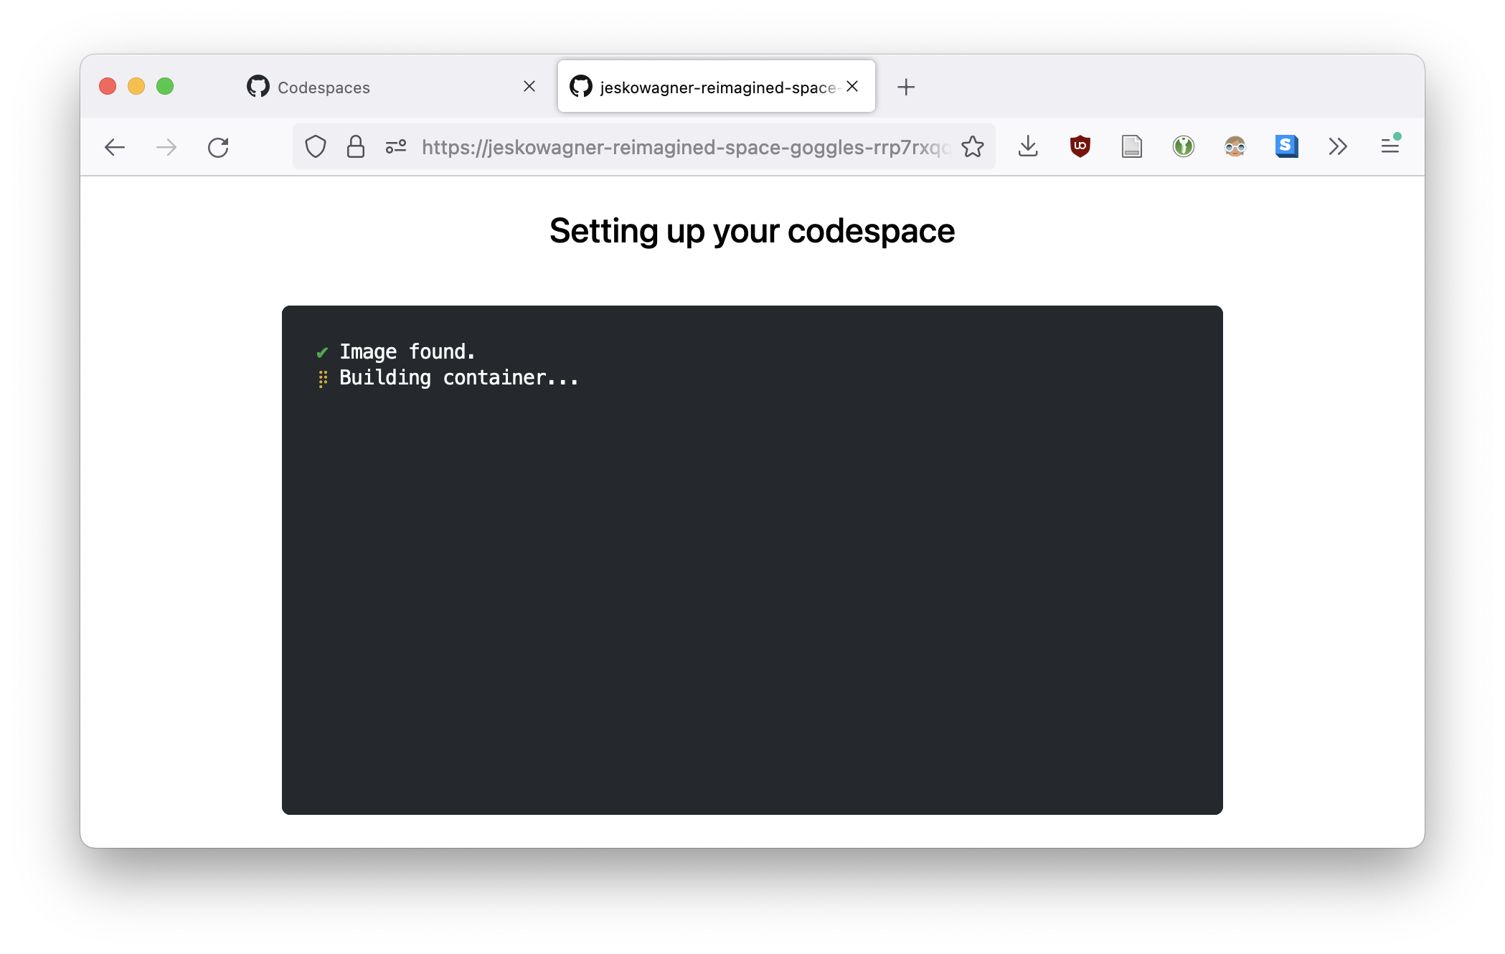
This takes around 4-5 minutes

Slide 7
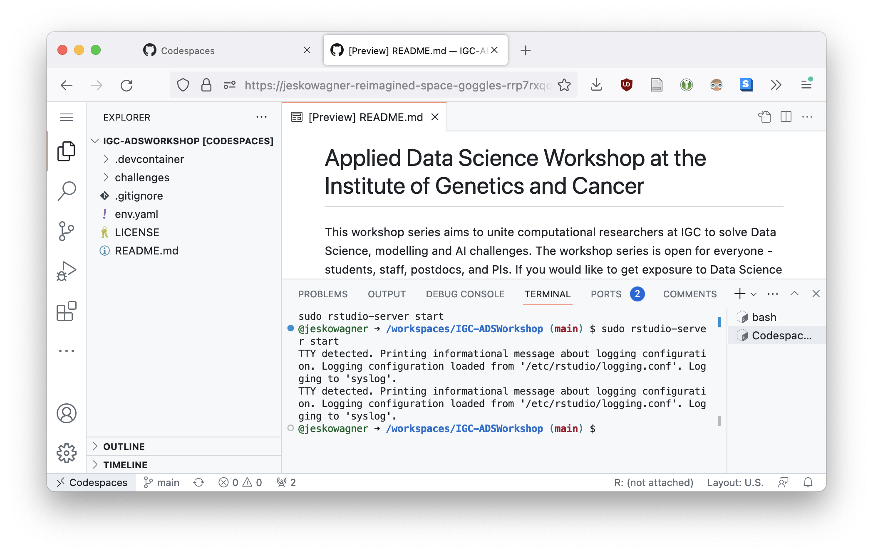
If you prefer VSCode over RStudio, feel free to get started here. Otherwise, continue to next slide

Slide 9
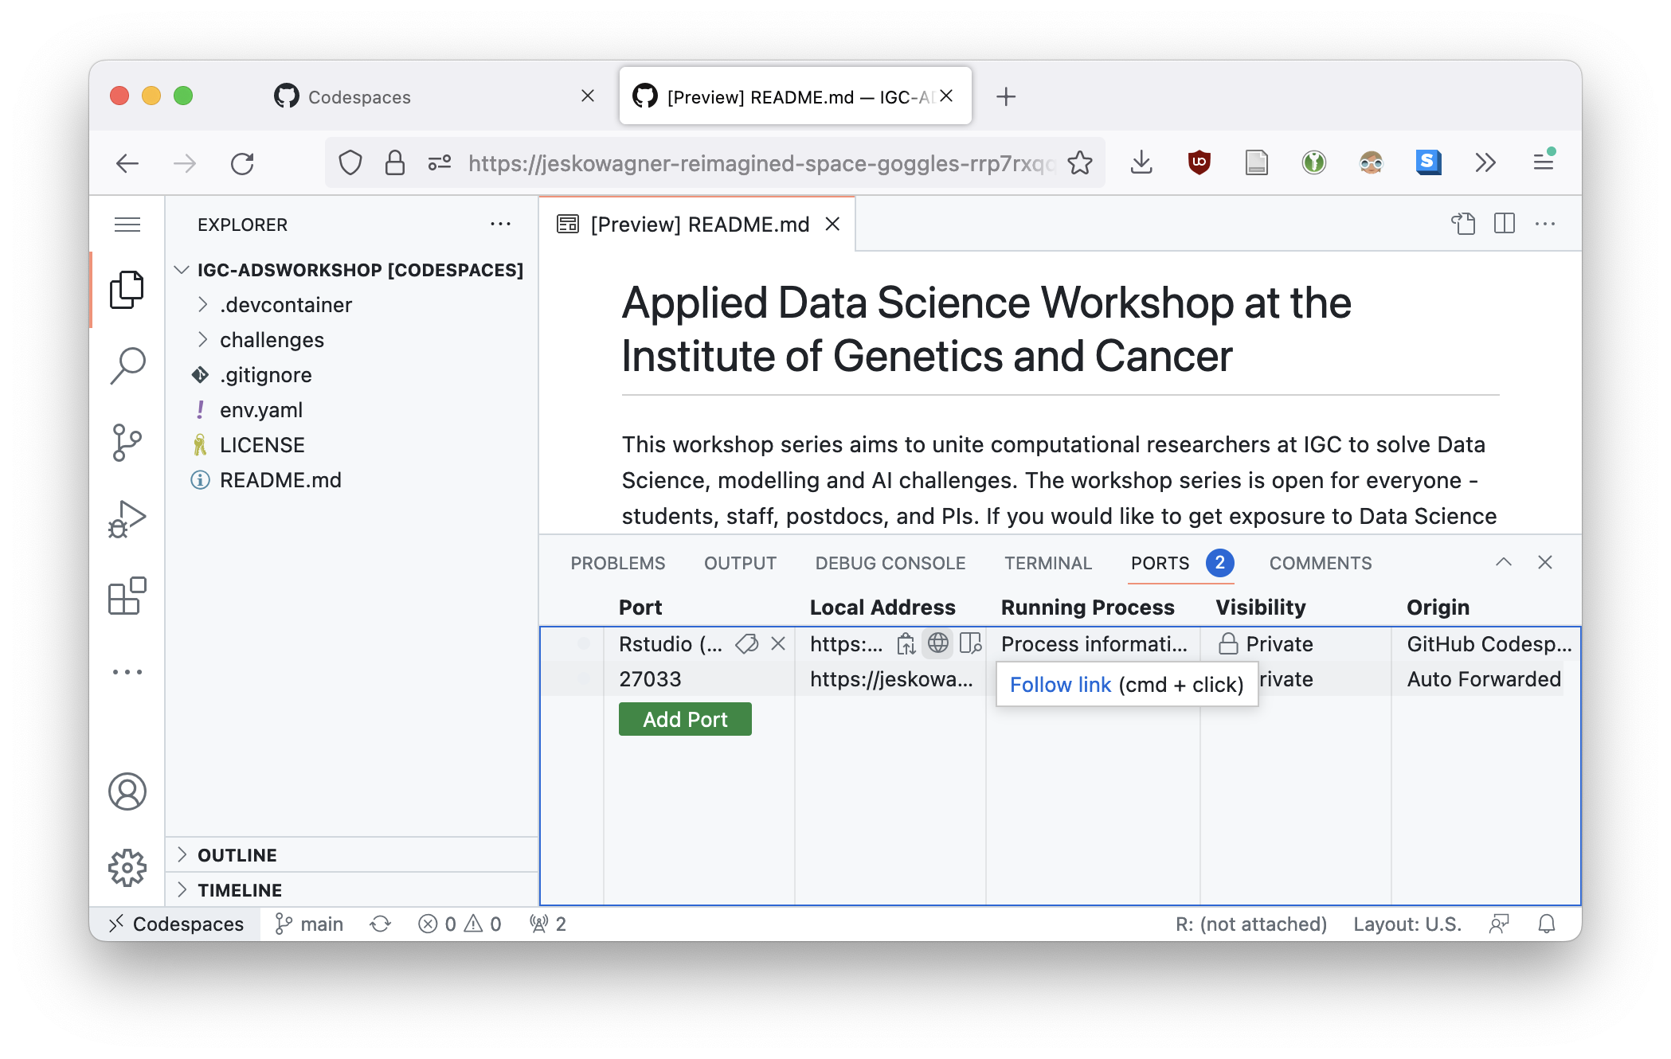
Hover over the highlighted area and click on the globe symbol

Slide 10
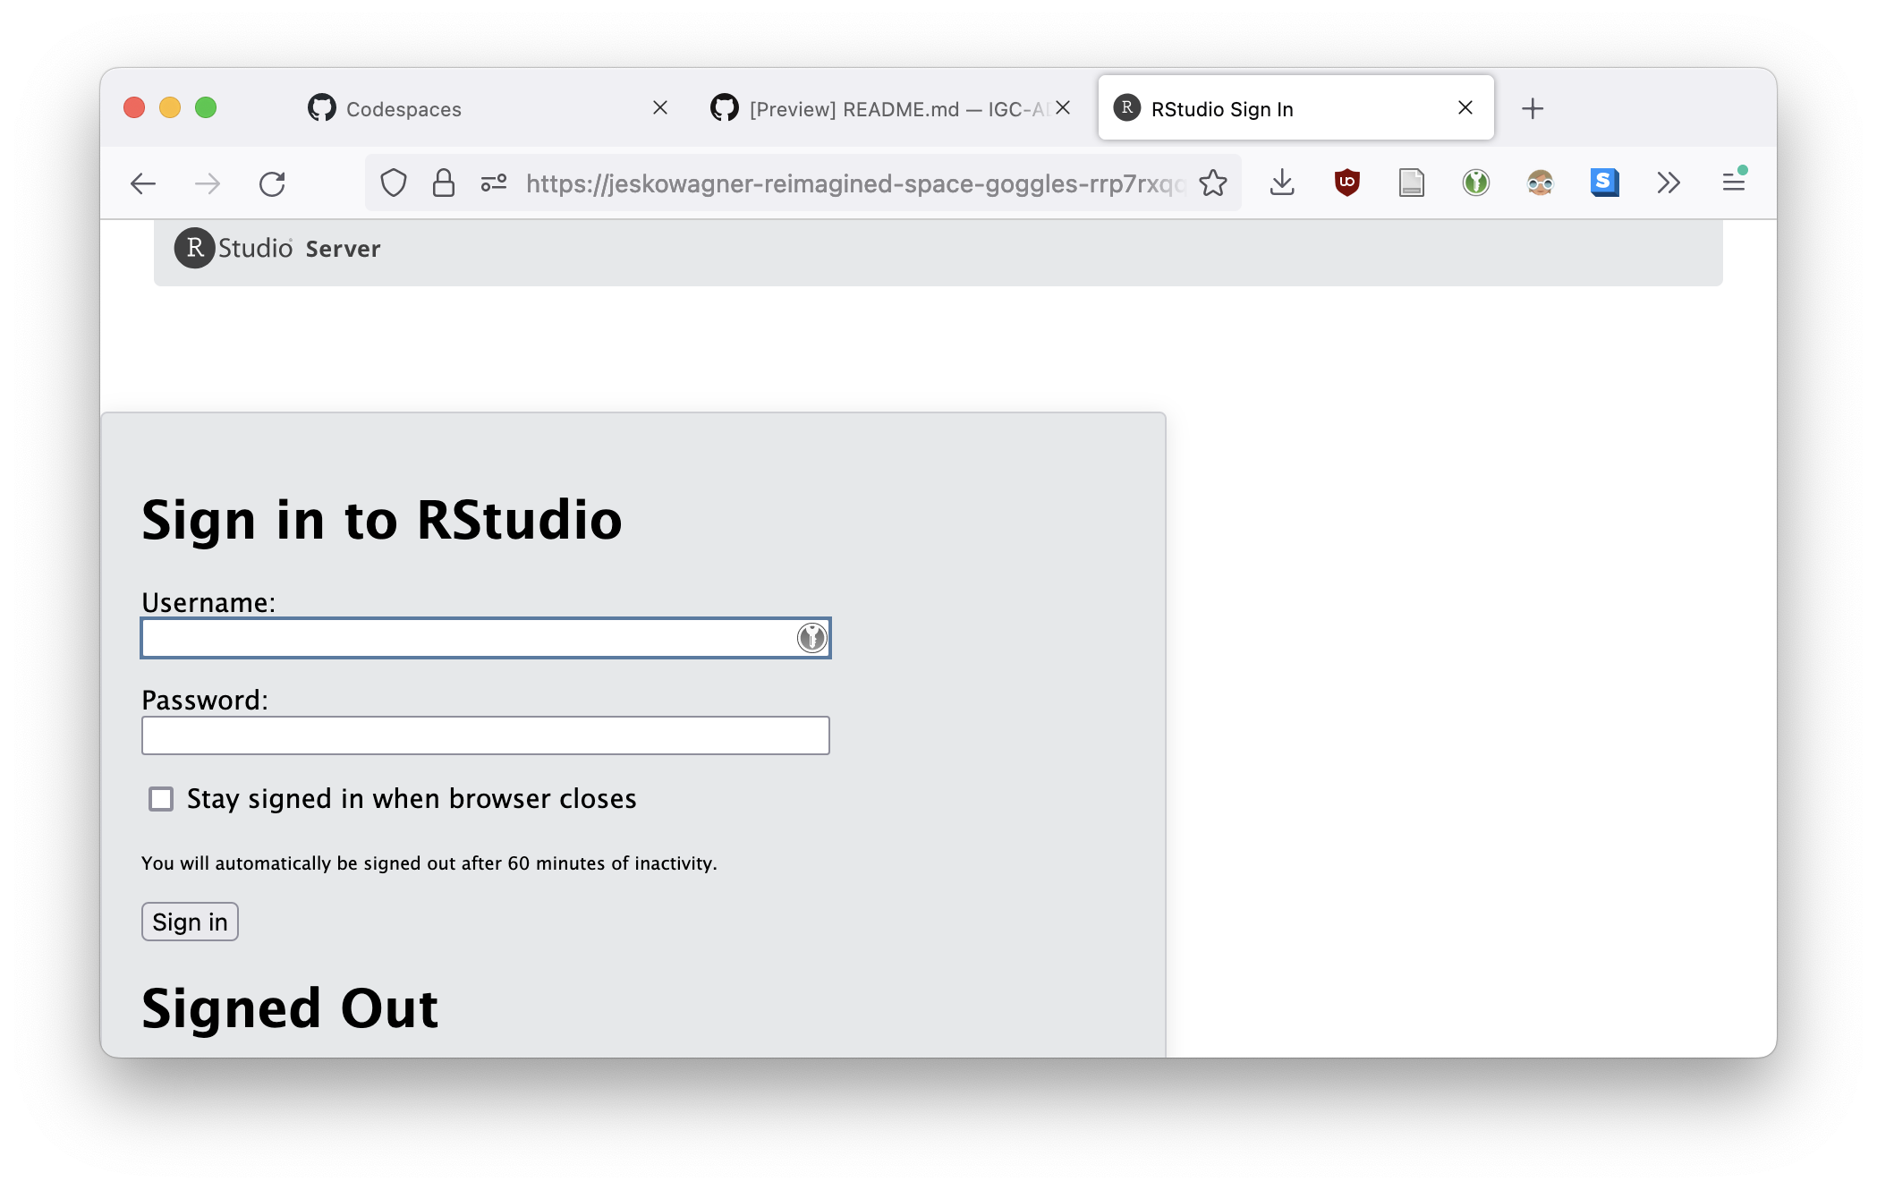
If you get an error message, wait 1-2 minutes, then try again. You should then get the below window.
Type “rstudio” (without quotes) for both username and password

Slide 11
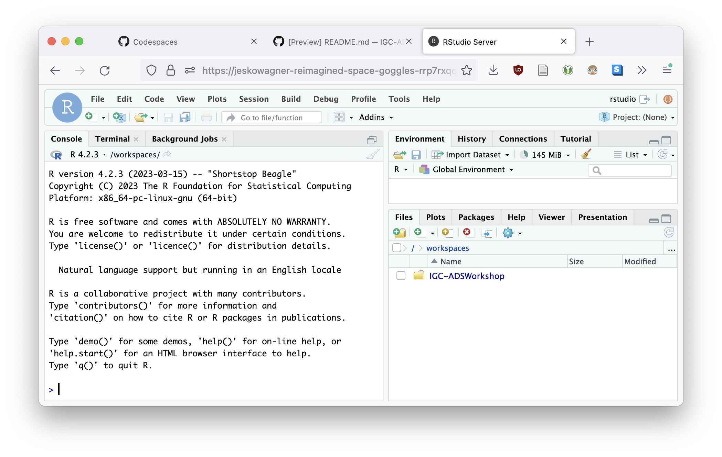
You should now have a fully functioning RStudio environment. Continue to the next slide to see how to open up the tutorial.

Slide 12
Using the file browser at the bottom right, click on the folder, then “challenges”, “2023-05-12”, “parkinson-walktrough.Rmd”

Slide 13
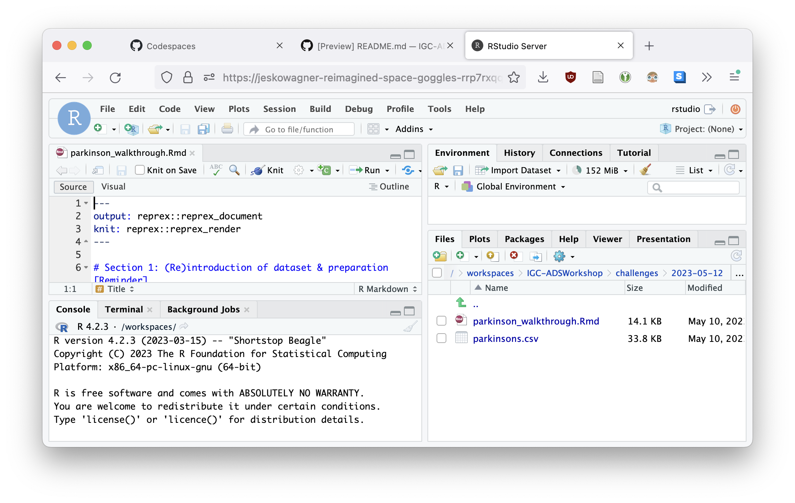
Click on “Visual”, and when prompted click “Use Visual Mode”

Slide 14
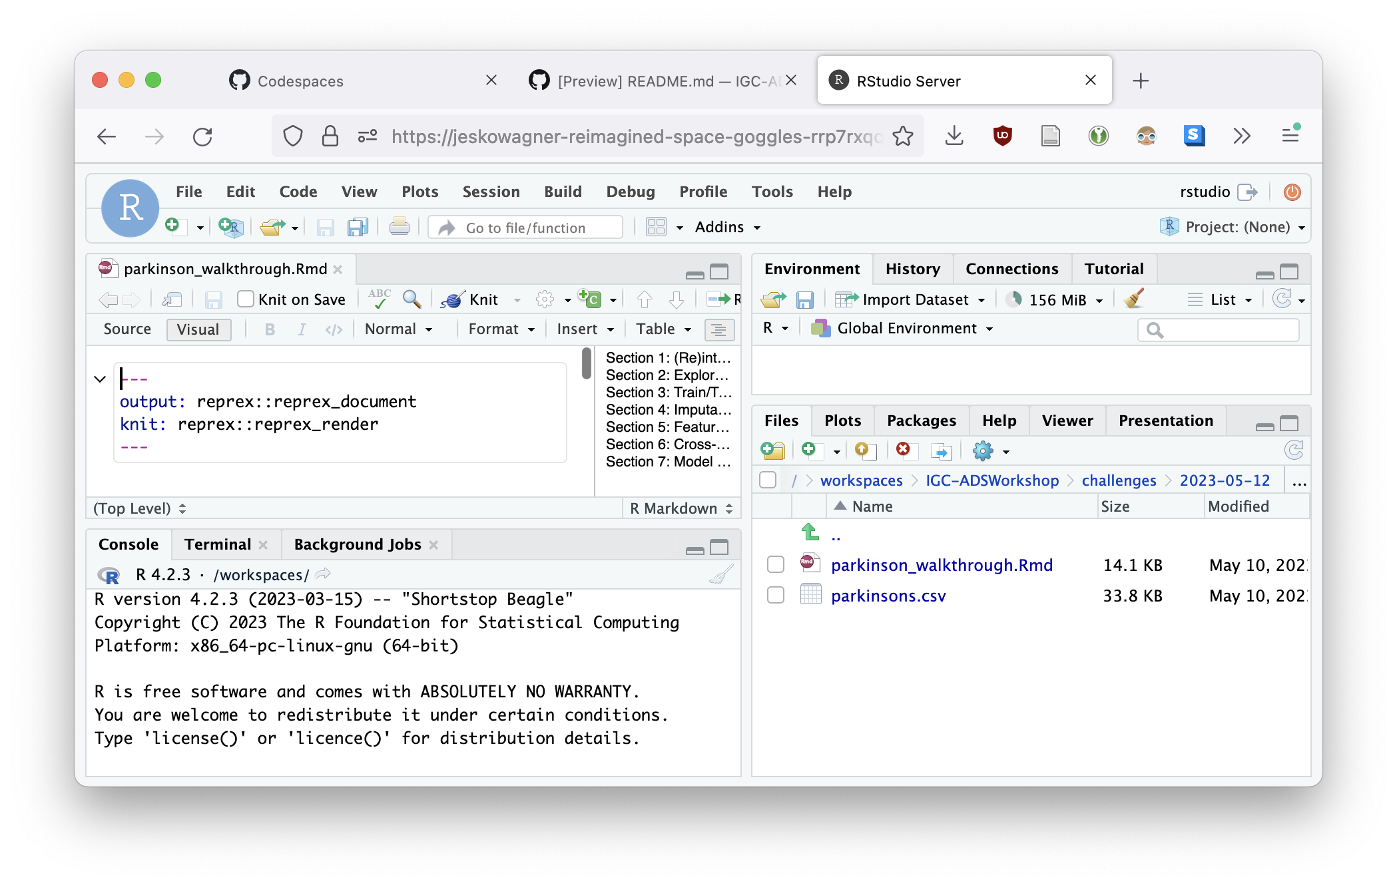
To get a larger view, feel free to minimize other windows
Drag to the right
Click

Slide 15
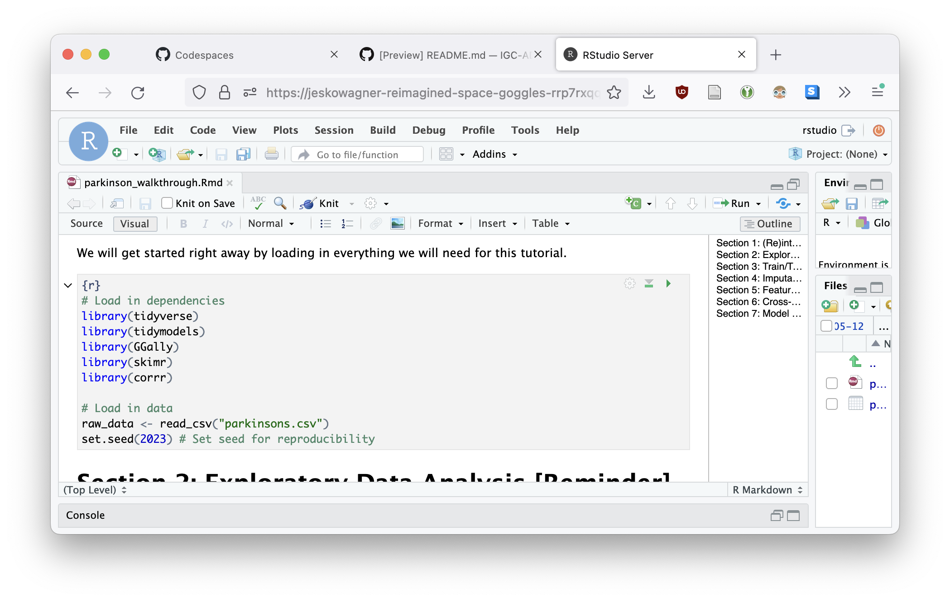
Run code by clicking on the green arrow. That’s all!

